Slide 1
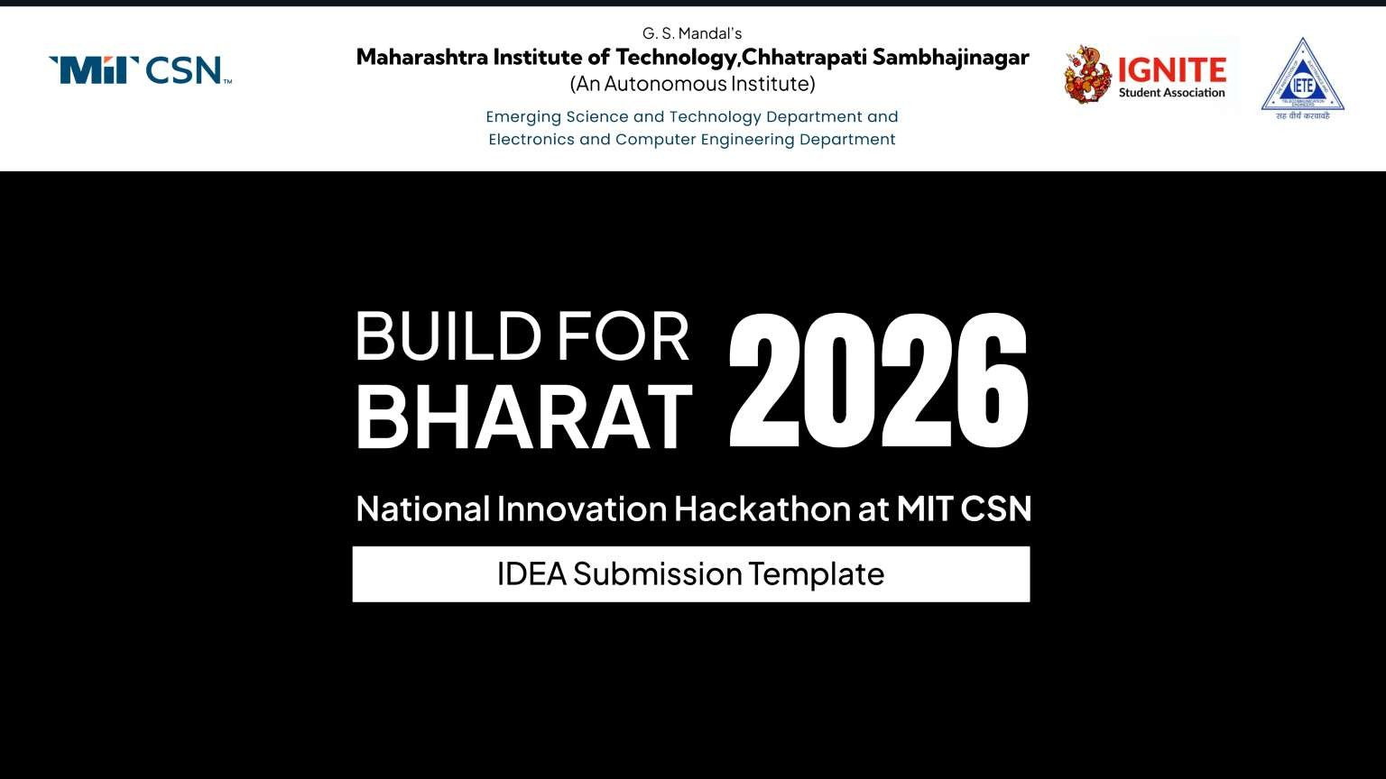
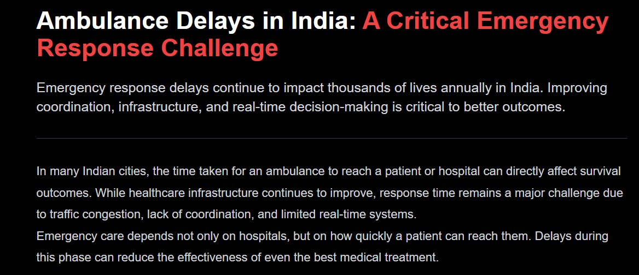

Slide 2
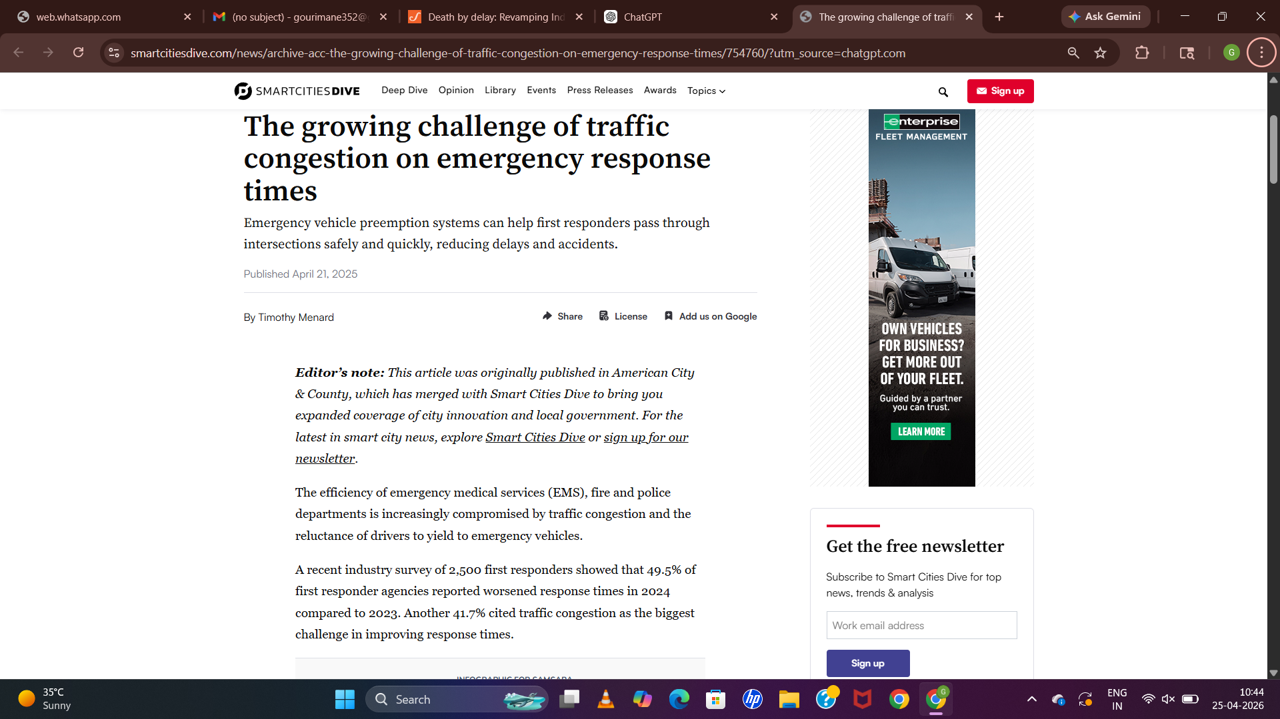
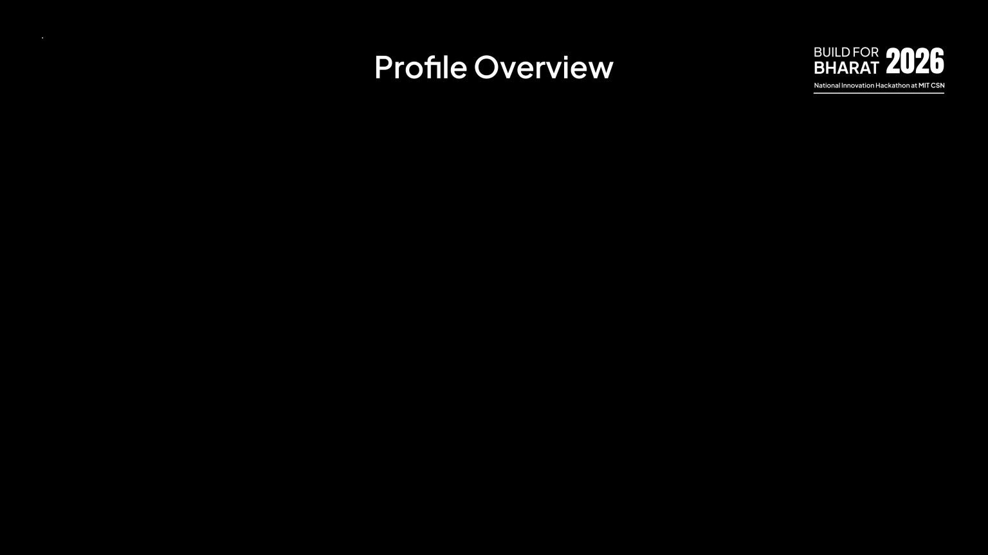


Slide 3
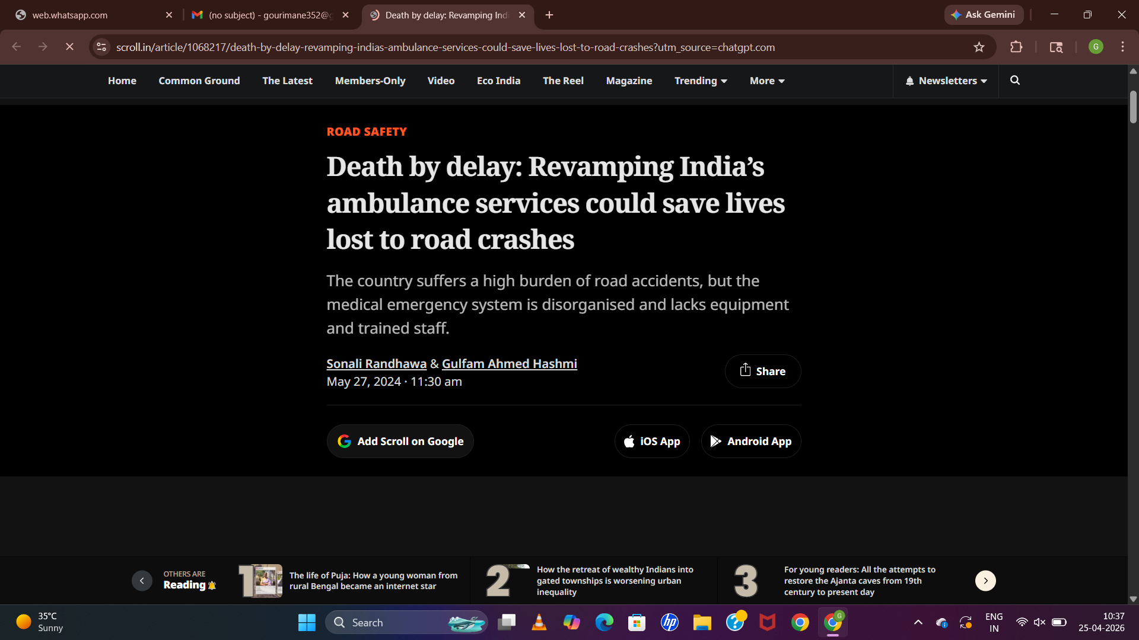
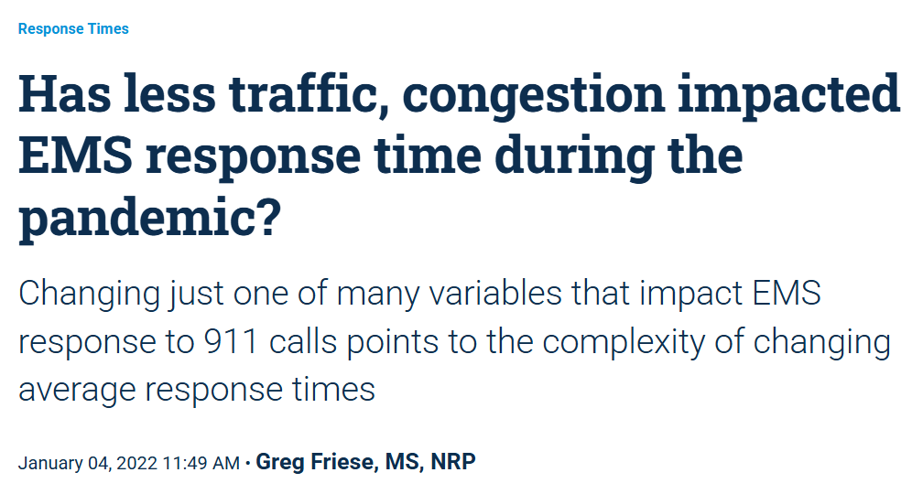

Slide 4
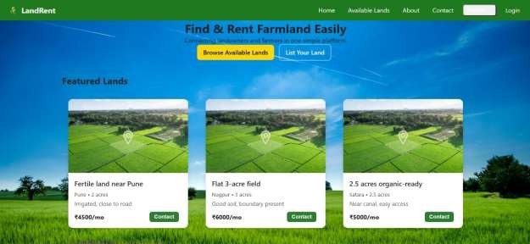
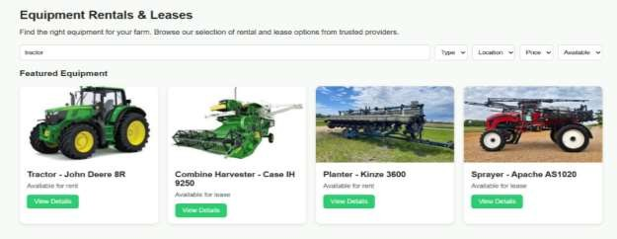
AGRIVEER – Digital Transformation of Agriculture
PROTOTYPE
IDEA / SOLUTION :
Create a digital platform (App + Website) that connects farmers, buyers, and service providers to solve challenges in agriculture.
Solutions:
We propose a mobile app + website that acts as a one- stop digital solution for farmers.
Land Renting Module – Farmers can lease unused
farmland or rent land for seasonal crops.
Equipment Sharing System – Owners can rent tractors, harvesters, and tools to other farmers when not in use.

Slide 5

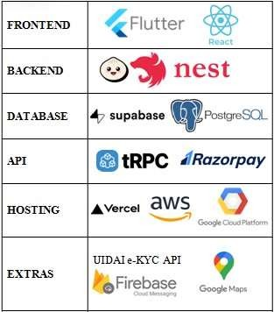
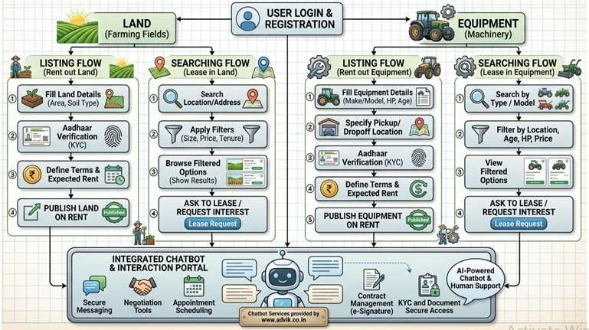
Technical Approach
TECH STACK
ARCHITECTURE/WORKLOW

Slide 6
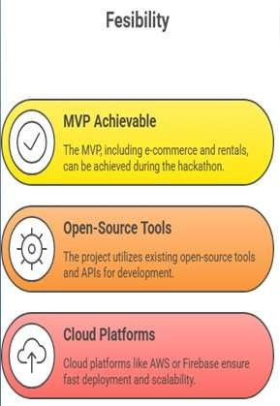
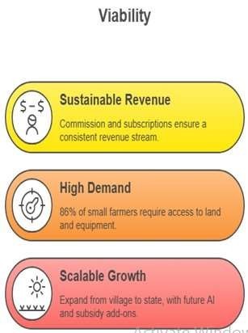
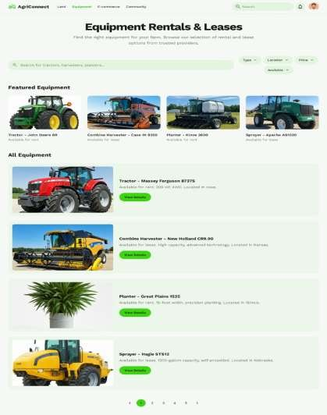
Feasibility and Viability
PROTOTYPE

Slide 7
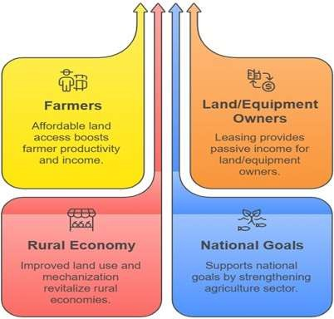
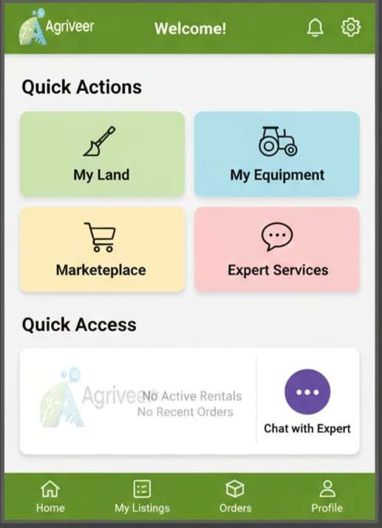
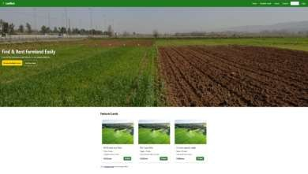
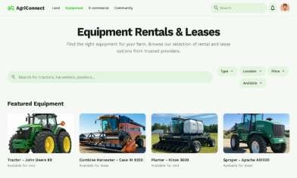
Impact and Benefits
PROTOTYPE
PROTOTYPE

Slide 8
Research and References
Govt. reports on agri sector (NITI Aayog, Ministry of Agriculture):- https://www.niti.gov.in/ , https://agriwelfare.gov.in/, https://www.accessagriculture.org/,
https://upag.gov.in/
FAO India agriculture insights :- https://www.fao.org/india/fao-in-india/india-at-a-glance/en/, https://agribegri.com/?srsltid=AfmBOooYVycXMH8rw35pH68zh1_xHu0Bcm0QzTpBf_8riUBEFu4rqwJy
Existing platforms (AgriBazaar, EM3 Agri, KisanKonnect):- https://www.agribazaar.com/
https://em3agri.com/ https://www.accessagriculture.org/ https://www.kisankonnect.in/?srsltid=AfmBOoqH3CZR0YIVPuCahWEcMnHln2, PHxlxLecKeQqGLxUWBs68DH2b, https://agmarknet.gov.in/,
https://agristack.gov.in/,
Farmer Producer Organizations (FPOs) models:-
https://farmerconnect.apeda.gov.in/Home/ForGroups?PaccessID=1,

